Slide 1


Computer Organization & Architecture
Chapter 17
Parallel Processing

Slide 2
18.1 Multiple Processor Organization
Classification of parallel processor system based on Flynn
  Single instruction, single data stream
  - SISD
  Single instruction, multiple data stream
  - SIMD
  Multiple instruction, single data stream
  - MISD
  Multiple instruction, multiple data stream
  - MIMD

Slide 3
SISD
  Single processor
  Single instruction stream
  Data stored in single memory
  Uni-processor
    Pipeline

Slide 4
SIMD
  Single machine instruction controls simultaneous execution of a number of processing elements
  Lockstep based
  Each processing element has associated data memory
  Each instruction executed on different set of data by different processors
    Vector and array processors

Slide 5
MISD
  Sequence of data
  Transmitted to set of processors
  Each processor executes different instruction sequence
    Never been implemented

Slide 6
MIMD
  Set of processors
  Simultaneously execute different instruction sequences
  Different sets of data
    SMPs, clusters and NUMA systems

Slide 7
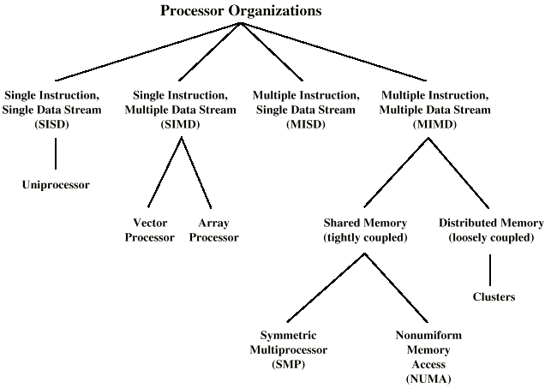
A Taxonomy of Parallel Processor Architectures

Slide 8
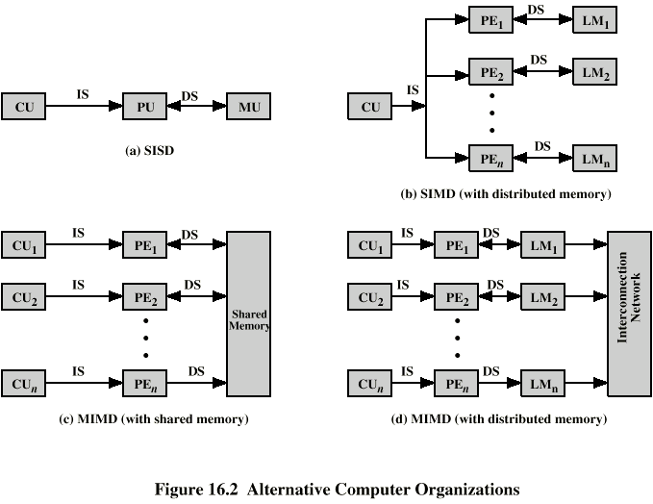
Parallel Organizations - SISD
  CU– control unit
  PU– processing unit
  MU– memory unit
  IS– instruction stream
  DS– data stream

Slide 9
Parallel Organizations - SIMD
  PE—processing element
  LM—local memory
    May be shared memory

Slide 10
MIMD - Overview
  General purpose processors
  Each can process all instructions necessary
  Further classified by method of processor communication
    Shared memory
      SMP– symmetric multiprocessor
      NUMA– non-uniform memory access
    Distributed memory
      clusters

Slide 11
Parallel Organizations - MIMD Shared Memory

Slide 12
Tightly Coupled - SMP
  Processors share memory
  Communicate via the shared memory
  Symmetric Multiprocessor (SMP)
    Share single memory or pool of memory
    By means of shared bus or other interconnection mechanism to access memory
    Memory access time to given area of memory is approximately the same for each processor

Slide 13
Parallel Organizations - MIMD Shared Memory
0-999
1000-1999
(n-1)*1000 –(n*1000-1)

Slide 14
Tightly Coupled - NUMA
  Non-uniform memory access
  Access times to different regions of memory may differ for a NUMA

Slide 15
Parallel Organizations - MIMD
Distributed Memory

Slide 16
Loosely Coupled - Clusters
  Collection of independent uniprocessors or SMPs
  Interconnected to form a cluster
  Communication via fixed path or network connections

Slide 17
Design Issues for MIMD
  Complex
  Issues considered:
    Physical organization
    Interconnection structures
    Inter-processor communication
    OS design
    Dedicated compiler
    Application software techniques
    Etc.

Slide 18
18.2 Symmetric Multiprocessors
A stand alone computer with the following characteristics
  Two or more similar processors of comparable capacity
  Processors share same memory and I/O
  Processors are connected by a bus or other internal connection
  Memory access time is approximately the same for each processor
  All processors share access to I/O
    Either through same channels or different channels giving paths to same devices
  All processors can perform the same functions (hence symmetric)
  System is controlled by integrated operating system
    providing interaction between processors and their programs at job, task, file and data element levels
    High degree of cooperation between processes

Slide 19
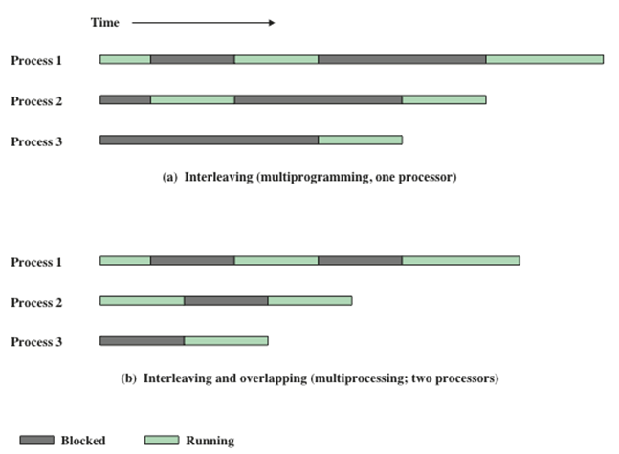
SMP Advantages
  Greater Performance
    If some work can be done in parallel

Slide 20
SMP Advantages
  Availability/fault-tolerance
    Since all processors can perform the same functions, failure of a single processor does not halt the system
  Incremental growth
    User can enhance performance by adding additional processors
  Scalable
    Vendors can offer range of products based on number of processors
  Existence of multiple processors is transparent to users
    The OS takes care of scheduling of threads or processes and of synchronization among processors

Slide 21
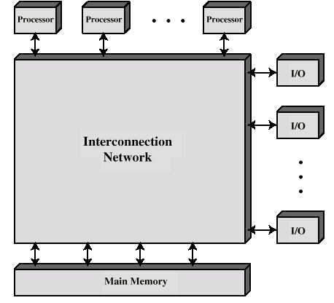
Block Diagram of Tightly Coupled Multiprocessor Organization
?

Slide 22
  Each processor is self-contained
    Including a control unit, ALU, registers and cache
  Through interconnection mechanism, processors may access shared memory and I/O devices
  The communications between processors may be through the shared memory
    Messages, status
  Many accesses to separate blocks of memory may be executed simultaneously
  In some configurations, each processor may have its own private memory and I/O channel besides the shared resources

Slide 23
Organization Classification of A Multiprocessor System
  Time shared or common bus
  Multiport memory
  Central control unit
  Interconnect networks

Slide 24
Time Shared Bus
  Simplest form
  Structure and interface similar to single processor system, see Fig
  Following features provided
    Addressing – where is the source and destination
    Arbitration - any module can be temporary master
    Time sharing - if one module has the bus, others must wait and may have to suspend
  Multiple processors as well as multiple I/O modules share the bus

Slide 25
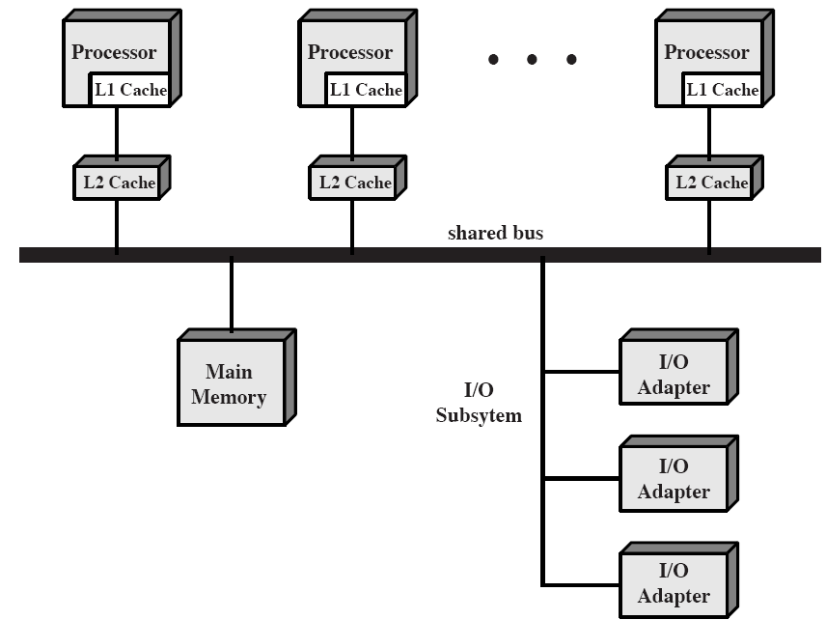
A SMP Organization

Slide 26
Time Share Bus- advantages &disadvantages
  Advantages:
    Simplicity
    Flexibility
      Expanding system is easy
    Reliability
      Failure of advice should not cause failure of the whole system
  Disadvantages
    Performance limited by bus cycle time
    Each processor should have local cache
      Reduce number of bus accesses
    Leads to problems with cache coherence
      Solved in hardware - see later

Slide 27
Multiport Memory
  Direct, independent access of memory modules by each processor or I/O module
  Logic required to resolve conflicts
    priority
  Little or no modification to processors or I/O modules required

Slide 28
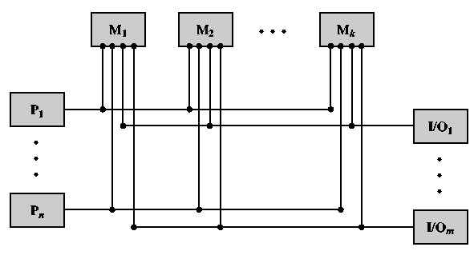
Multiport Memory

Slide 29
Multiport Memory
- Advantages & Disadvantages
  Better performance
    Each processor has dedicated path to each module
  Can configure portions of memory as private to one or more processors
    Increased security, uneasy to be modified by other processors
  More complex control
    Extra logic in memory system
  Write through cache policy should be used for cache control
    Communication between processors are only through memory

Slide 30
Multiprocessor OS Design Issues
  A SMP OS provides all the functions of a multiprogramming system and features to accommodate multiple processors
    Simultaneous concurrent processes
      Allow processors to execute the same IS codes simultaneously, and to avoid deadlock
    Scheduling
    Synchronization
      Access shared resources exclusively
    Memory management
      Multiport memory
      Consistency, when several processors share a page, segment
      A new mechanism of page replacement
    Reliability and fault tolerance
      Recognize the failure of a processor and restructure management tables

Slide 31
18.5 Clusters
Alternative to SMP
A group of interconnected whole computers
Working together as unified resource
Illusion of being one machine
Each computer called a node
High performance
High availability
Server applications and HPC

Slide 32
Cluster Benefits
  Absolute scalability
    A cluster can have dozens of machines, each of which may be a multiprocessor
  Incremental scalability
    Gradually expand the cluster
  High availability
    Very good fault tolerance
  Superior price/performance
    Higher performance and lower cost

Slide 33
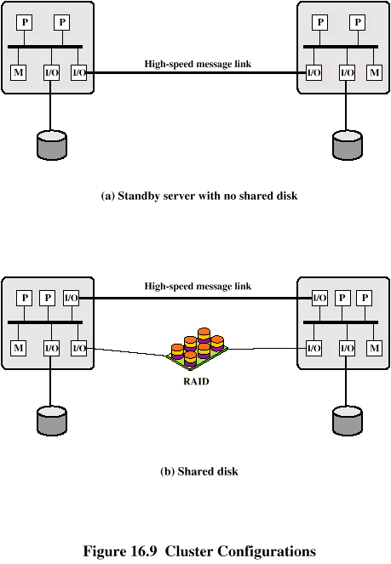
Cluster Configurations - Standby Server, No Shared Disk

Slide 34
Cluster Configurations - Shared Disk

Slide 35
Light Weight Clusters
  Passive standby
    Primary periodically heart beats to standby
  Active secondary: secondary is also used for processing tasks
    Separate servers
      Two separately running servers need load balancing and data transfer to each other
    Servers connected to disks
      Each server owns its disk. If one server fails, its disks are taken over by others, called shared nothing
    Servers shared disks
      Lock mechanism to synchronization

Slide 36
OS Design Issues for Cluster
  Failure management
  Load balancing
  Parallelizing computation

Slide 37
18.6 Non-uniform Memory Access System
NUMA– non-uniform memory access:
  The memory access time of a processor differs depending on location of memory accessed
  See Fig18.11
CC-NUMA—cache-coherent NUMA
  A NUMA system with cache coherence of various processors
A NUMA system without cache coherence is more or less equivalent to a cluster

Slide 38
Why NUMA is needed?
  With a SMP system, as the number of processors increases, the bus may become a performance bottleneck
    The bus traffic increases
    Cache coherence signals further add to the burden
    So, processors are not infinite scalable
      Typically, 16~64 processors in SMP
  With a cluster, each node has its own private main memory, applications do not see a large global memory and this affects to achieve maximum performance
  NUMA can compensate above limitations

Slide 39
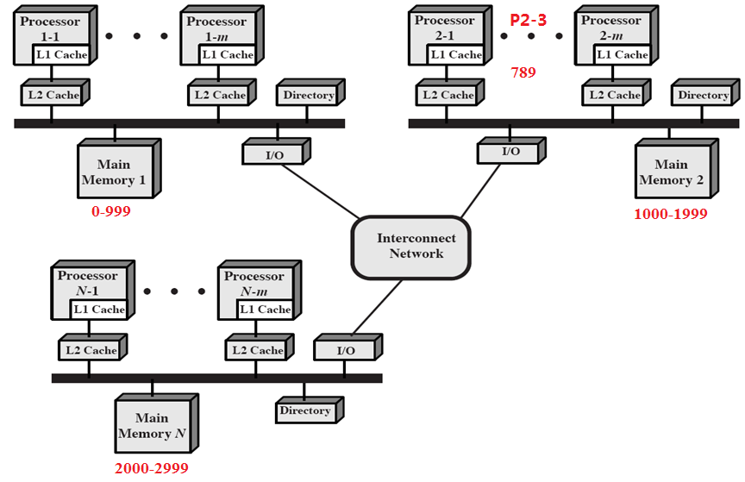
CC-NUMA Organization

Slide 40
CC-NUMA Organization
  Fig.18.11depicts a typical CC-NUMA system
  Multiple independent nodes are interconnected by some communication facility
  Each node is a SMP containing multiple processors
  Each processor has its own L1 &L2 caches as well as memory. But a processor may access multiple memory
    There is only a single addressable memory, with each location having a unique system-wide address

Slide 41
Operation of Access
  When a processor initiates a memory access
    Access L1 cache, if missed
    Access L2 cache, if missed
    Local memory address?
    An automatic request is sent out to fetch desired line across the interconnection network
    The returned data are delivered to requesting cache through network and local buses
  These actions are automatic and transparent to the processor and its cache

Slide 42
An Example(1)
  Suppose processor 3 on node 2 in the Fig. requests a memory location 798, which is in the memory of node 1. Sequence occurred:
    P2-3 issues a read request on the snoopy bus
    The directory on node 2 sees and recognize the location is in node 1
    Node 2’directory signals to node 1,which is picked up by node 1’directory
    Node 1’directory, acting as a surrogate of P2-3, requests the contents of 798, as if it were a processor

Slide 43
  Node 1’main memory responds and puts the requested data on the bus
  Node1’directory picks up the data and transferred it to node2’directory
  Node2’directory places the data back on node2’bus
  The data is picked up and placed in P2-3’s cache and delivered to P2-3

Slide 44
NUMA Pros and Cons
  Pros
    Higher levels of parallelism than SMP,without major software changes
    The network traffic is limited, because remote accesses are not excessive
      L1,L2 cache,local memory,virtual memory
      Programs have temporal and spatial locality
      Page migration mechanism—mobile agent
  Cons
    Need a new OS to support
    Availability
      Depend on the exact system implementation

Slide 45
Key Points
  Taxonomy of parallel processor architecture
  SMP
    Characteristics
    Organization modes
    OS
  Clusters
    Configurations
    Applications
    OS
  NUMA
    Organization
    Memory access

